Slide 1

Deep Learning-Based Detection and Localization of Intracranial Hemorrhage Types
Team PixelMedics

Slide 2

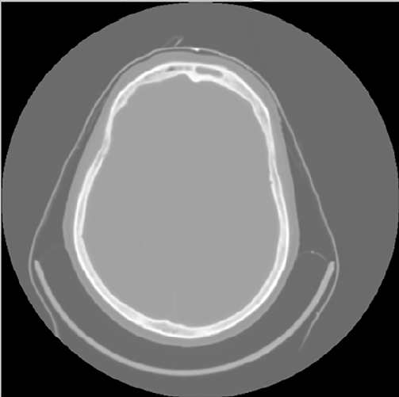
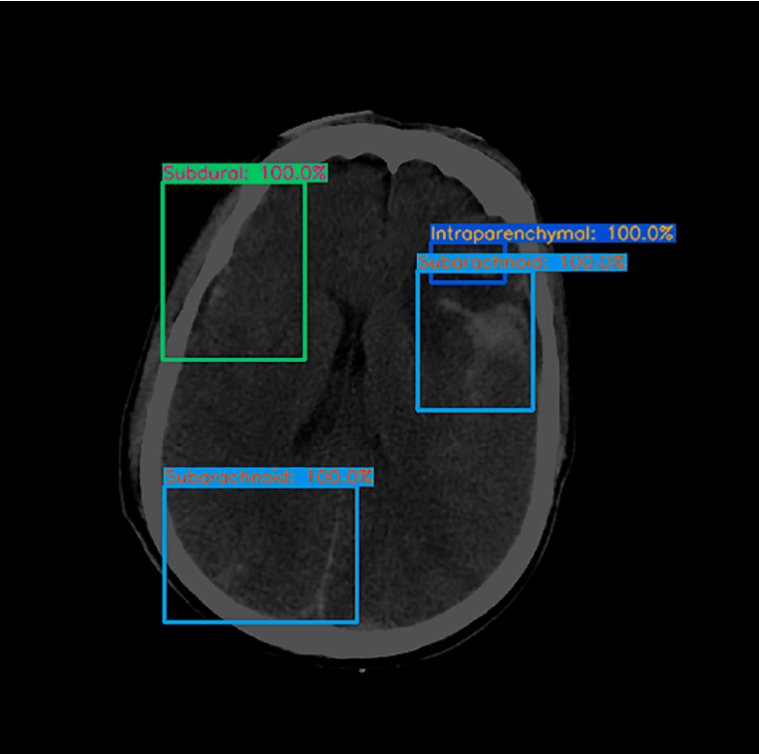

INTRODUCTION
Deep learning model
CT scan image
Annotated output

Slide 3
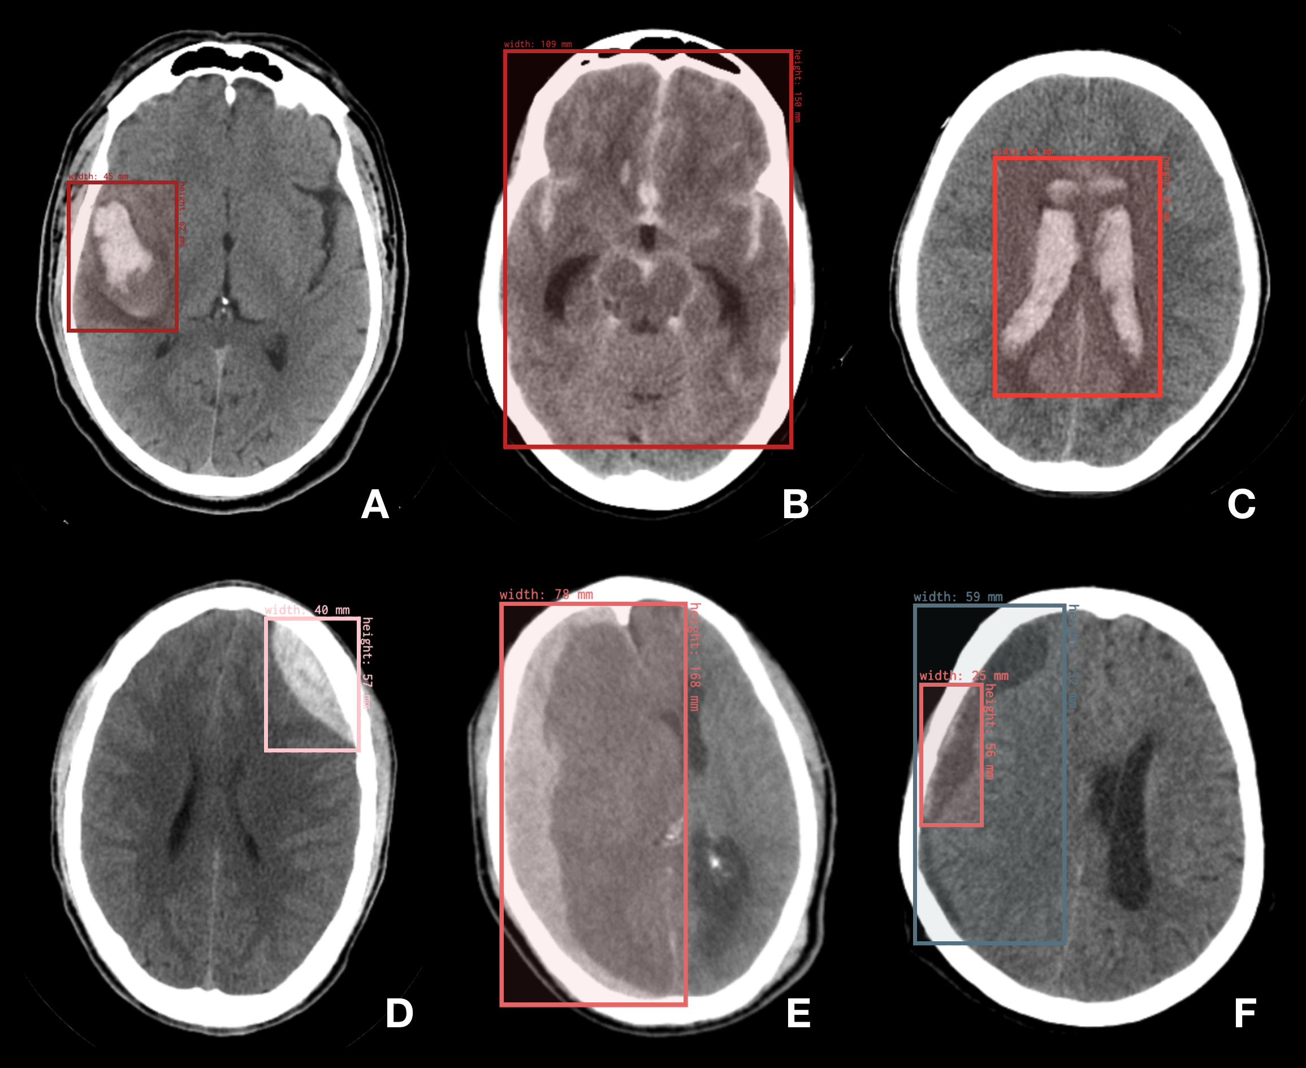
BHX Dataset
BHX contains up to 39,668 bounding boxes in 23,409 images annotated for hemorrhage, out of a total of ~170k images from qure.ai CQ500 dataset.
Version 1:
Initial_Manual_Labeling
Version2:
Extrapolation_to_All_Series
Version 3:
Extrapolation_to_Selected_Series
Notes:
Version 1 (file "1_Initial_Manual_Labeling.csv") contains only the hand-drawn annotations of the thick-slices.
Version 2 (file "2_Extrapolation_to_All_Series.csv") contains the thick-slices hand-drawn annotations as well as the extrapolation for all other corresponding images, regardless of whether they are bone filter or series with contrast.
Version 3 (file "3_Extrapolation_to_Selected_Series.csv") contains the thick-slices hand-drawn annotations as well as the extrapolation for the selected soft-tissue non-contrast-enhanced series only.

Slide 4
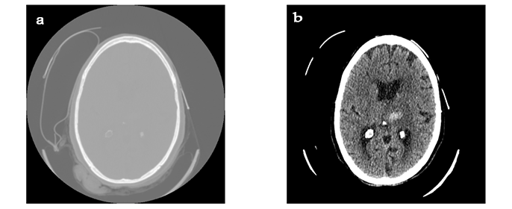
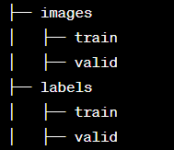
Data Pre-processing and Preparation
Pre-processing
Transformation to Hounsfield Unit (HU)
Windowing
Normalization
Morphology Dilation
Dimension Squeezing
Preparation
More than one bounding box in a scan image
Training and testing spitting
Organizing

Slide 5

YOLOv8
State-of-the-art object detection algorithm that offers exceptional performance in terms of accuracy and speed.
Use in medical imaging analysis
Fine-tuned model to have 6 output classes
CIoU loss (Complete Intersection over Union) during training contributes to improved bounding box regression, leading to more accurate localization of objects.
Adam optimizer
350 epochs

Slide 6
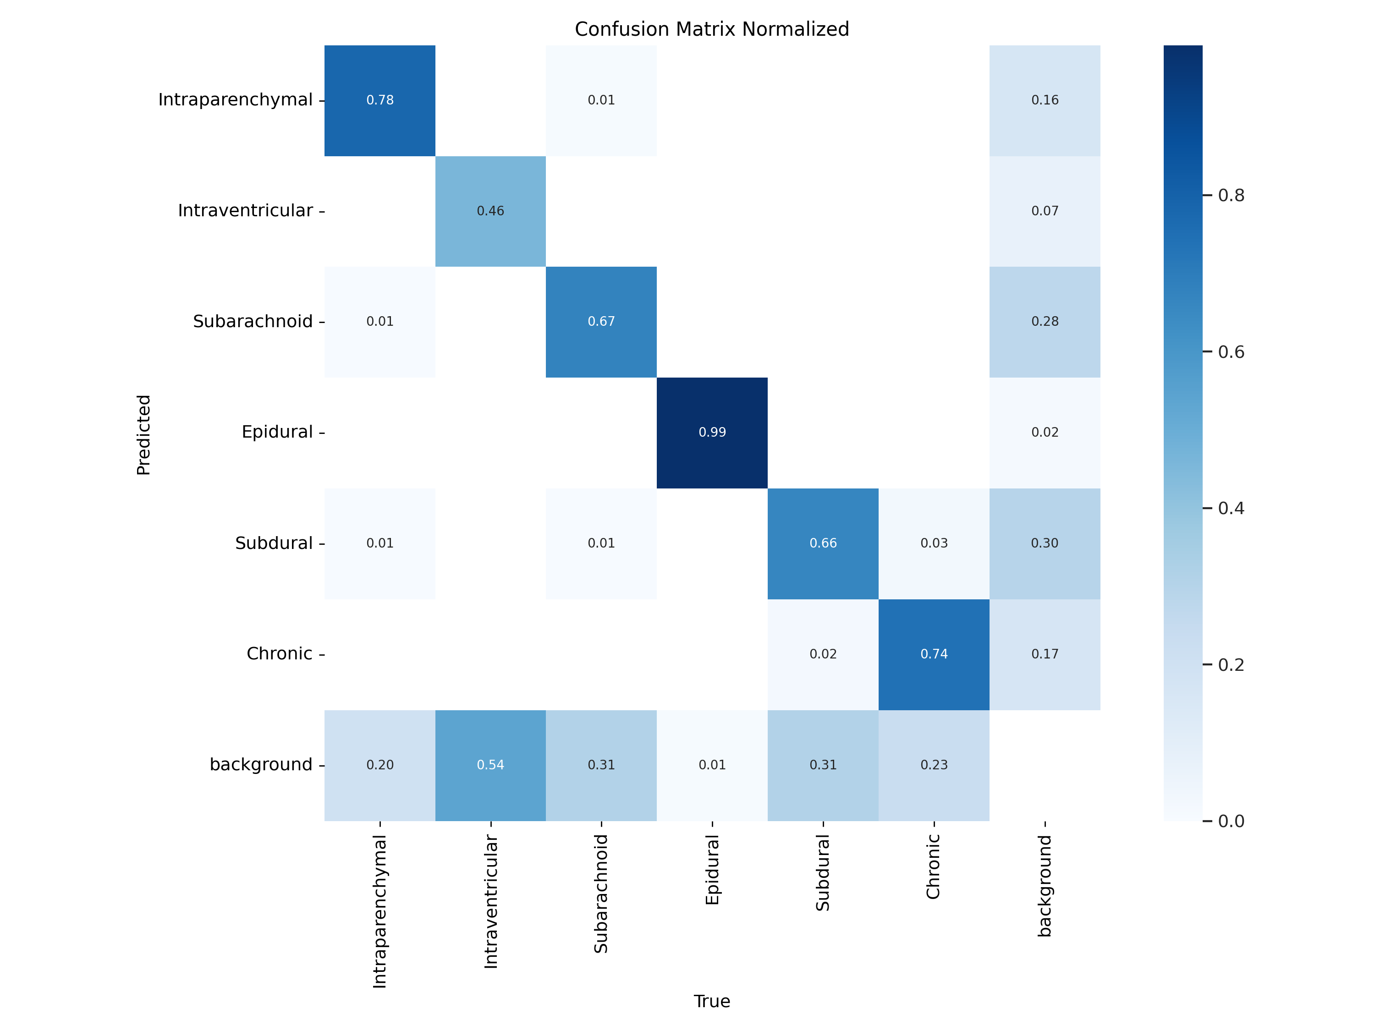
Results
Normalized confusion matrix

Slide 7
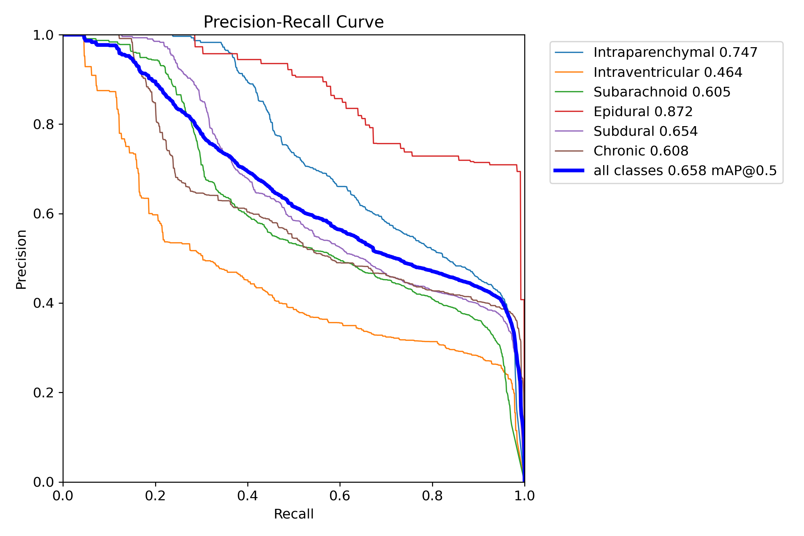
Precision vs. Recall curve

Slide 8
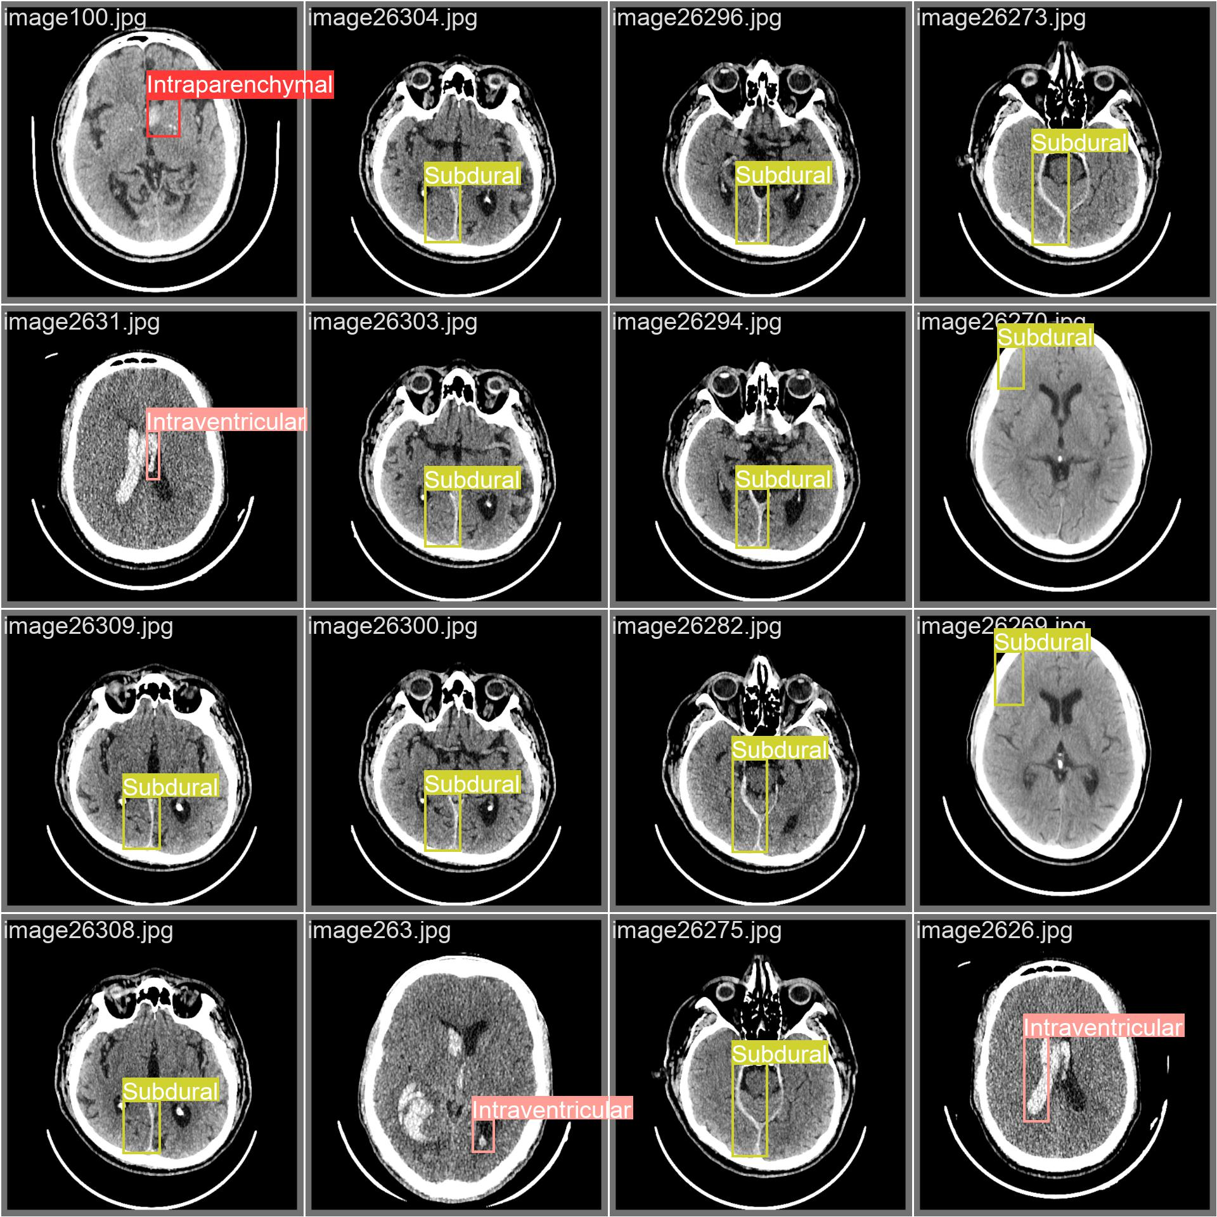
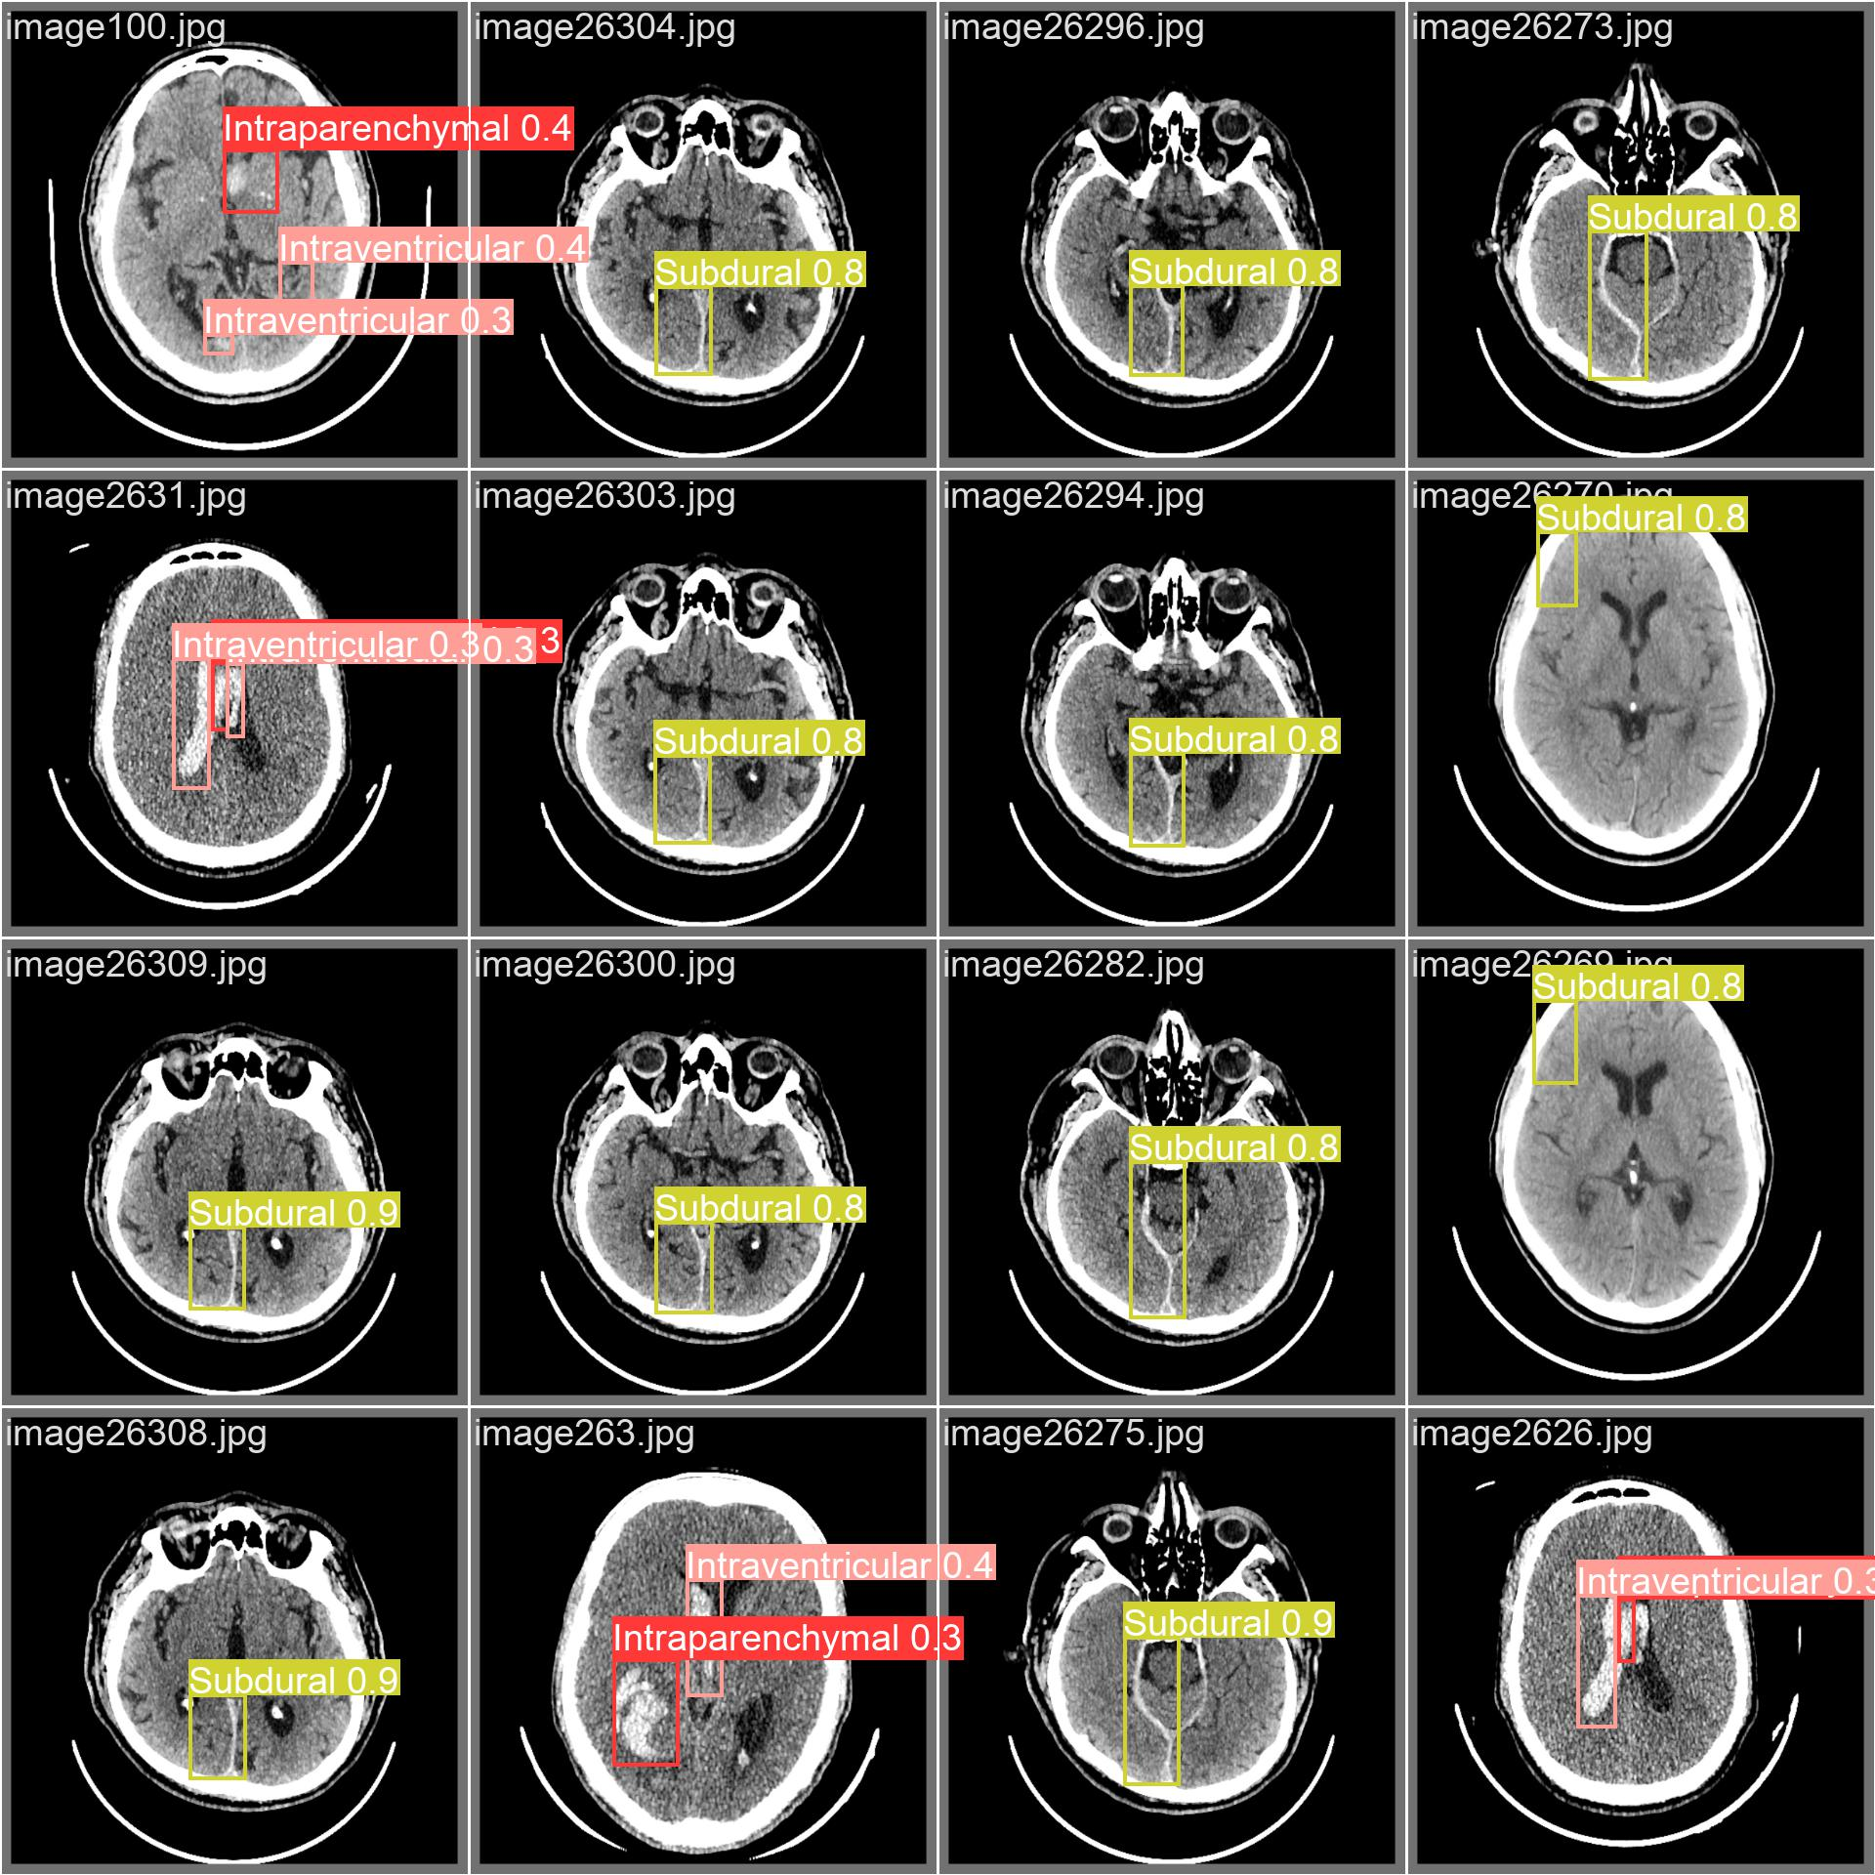
Validation batch
Predicted batch

Slide 9
Thank You!

